Slide 1
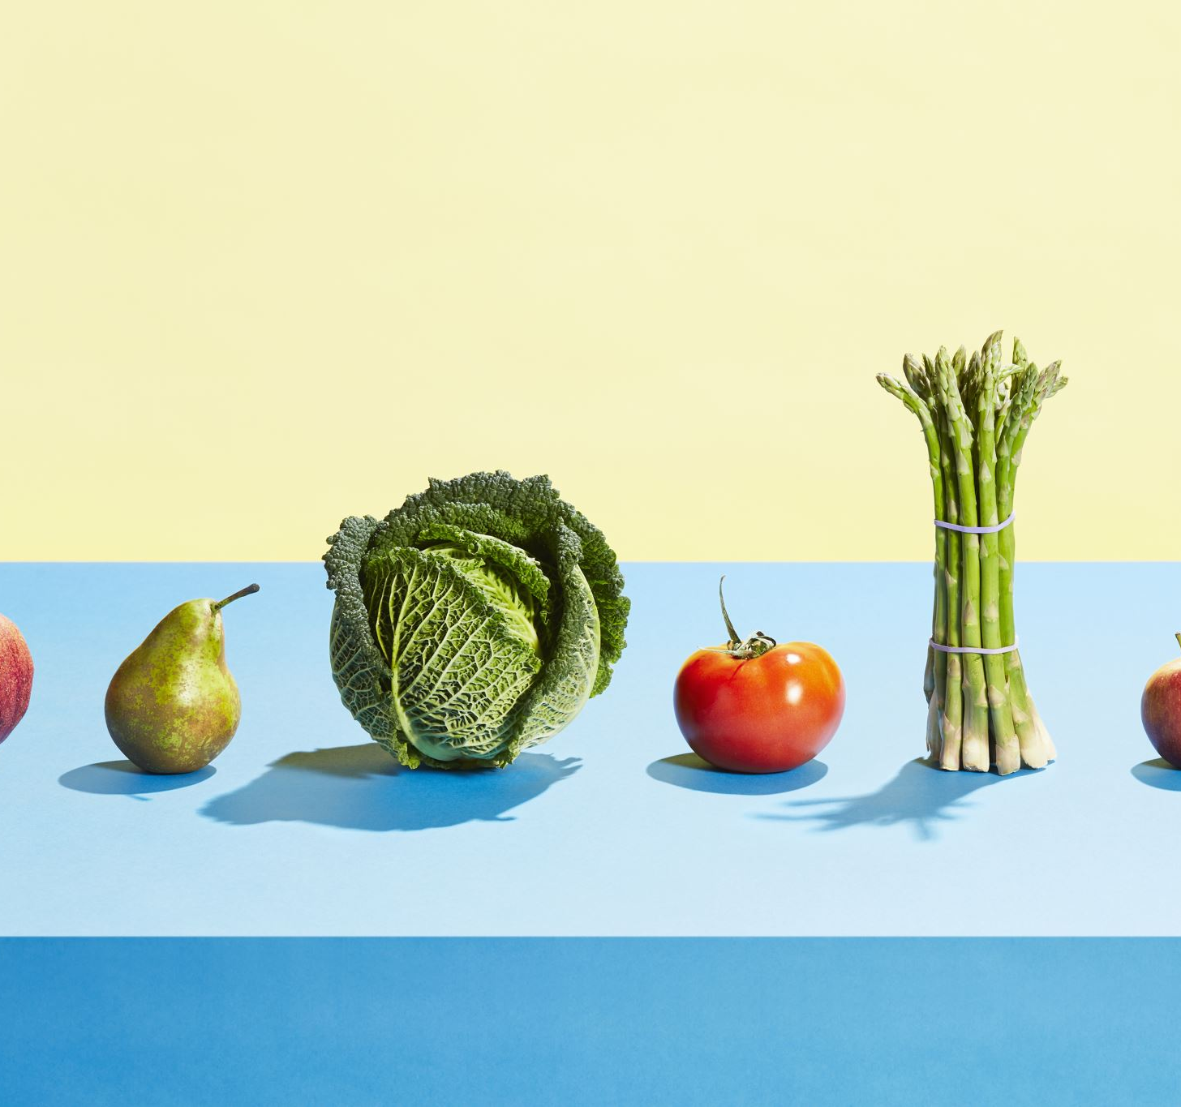

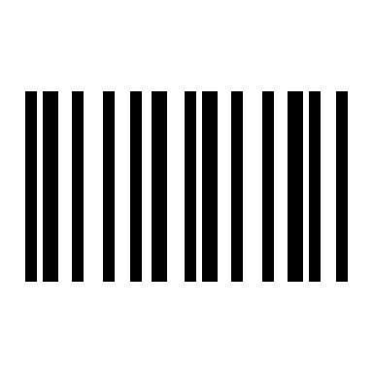
Thought For Food : A web application for tracking health data
Our goal for the app is to use information from the end-user and give evidence-based feedback on the health impact of an entered item
Our current state has the potential to help people with hypertension limit their sodium and saturated fat intake
Presented by:
Nathaniel Phillips, Elisabeth Federici,
and Zoe Luter
Check out our repository here!

